Slide 1


Slide 2


Slide 3


Slide 4

Notes:
If the company has relevant traction, add a simple overview of your revenue or MoM growth, without getting into too many details about the business itself.Skip this slide if you don't have strong numbers yet.

Slide 5
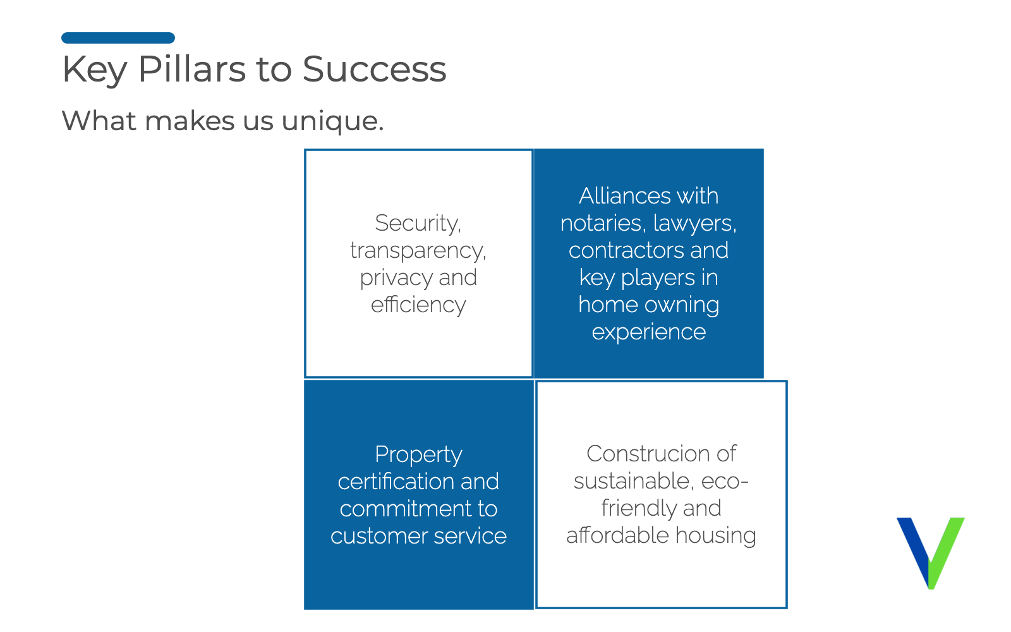
Notes:
If the company has relevant traction, add a simple overview of your revenue or MoM growth, without getting into too many details about the business itself.Skip this slide if you don't have strong numbers yet.

Slide 6
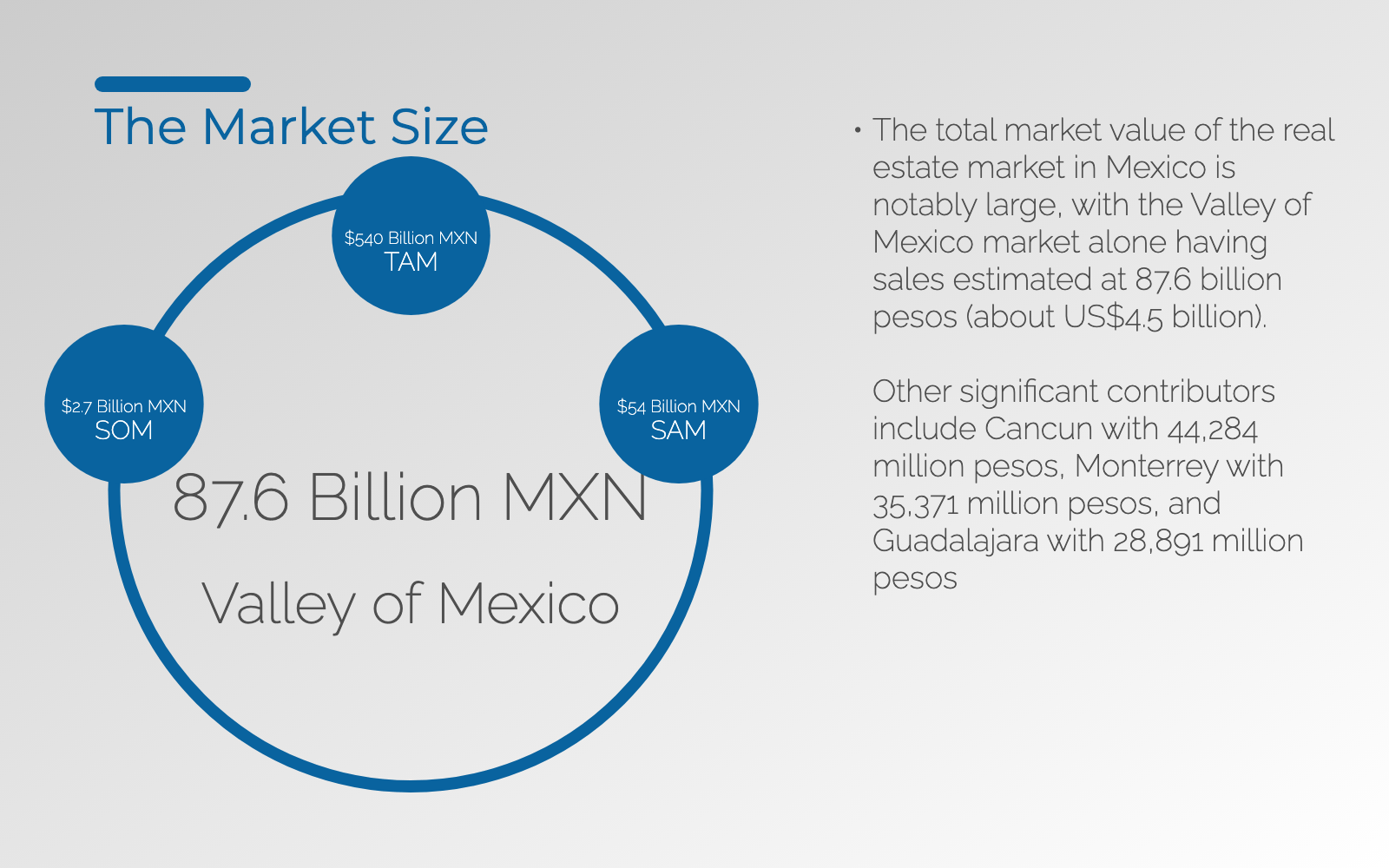
Notes:
If the company has relevant traction, add a simple overview of your revenue or MoM growth, without getting into too many details about the business itself.Skip this slide if you don't have strong numbers yet.

Slide 7


Slide 8

Notes:
If the company has relevant traction, add a simple overview of your revenue or MoM growth, without getting into too many details about the business itself.Skip this slide if you don't have strong numbers yet.

Slide 9

Notes:
If the company has relevant traction, add a simple overview of your revenue or MoM growth, without getting into too many details about the business itself.Skip this slide if you don't have strong numbers yet.

Slide 10

Notes:
If the company has relevant traction, add a simple overview of your revenue or MoM growth, without getting into too many details about the business itself.Skip this slide if you don't have strong numbers yet.

Slide 11
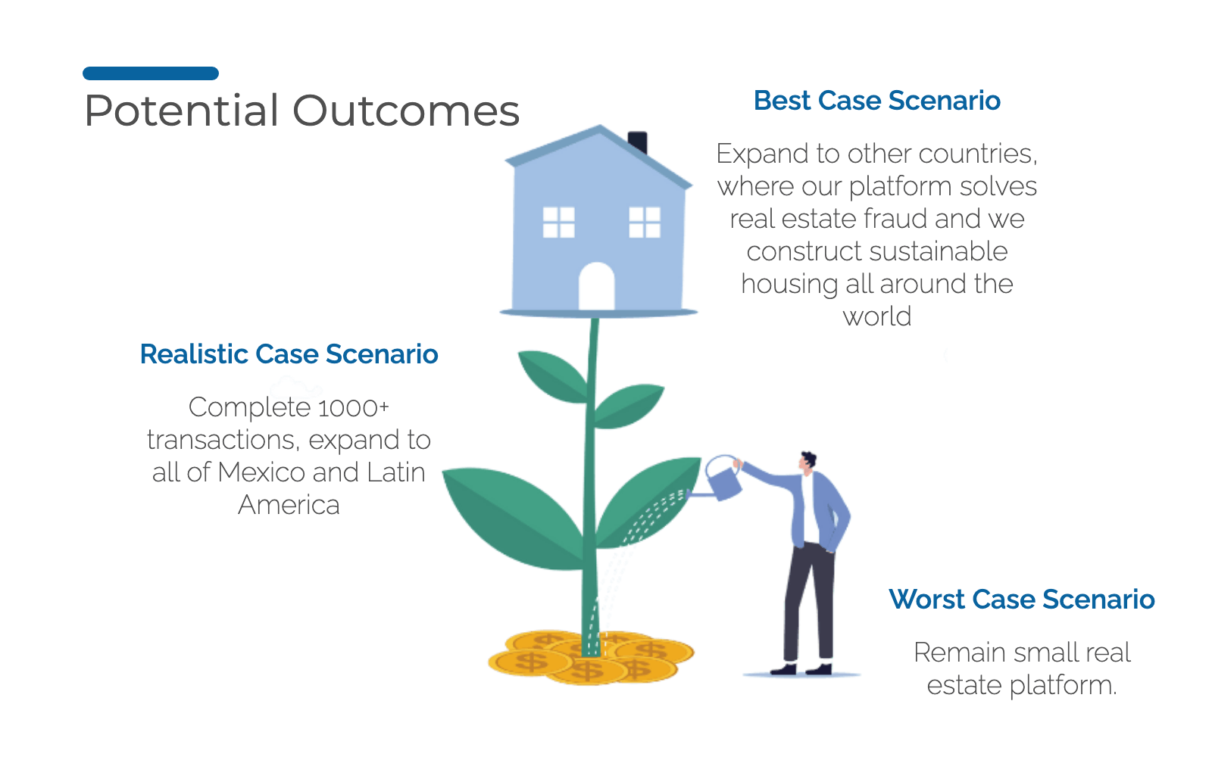
Notes:
If the company has relevant traction, add a simple overview of your revenue or MoM growth, without getting into too many details about the business itself.Skip this slide if you don't have strong numbers yet.

Slide 12

Notes:
If the company has relevant traction, add a simple overview of your revenue or MoM growth, without getting into too many details about the business itself.Skip this slide if you don't have strong numbers yet.

Slide 13
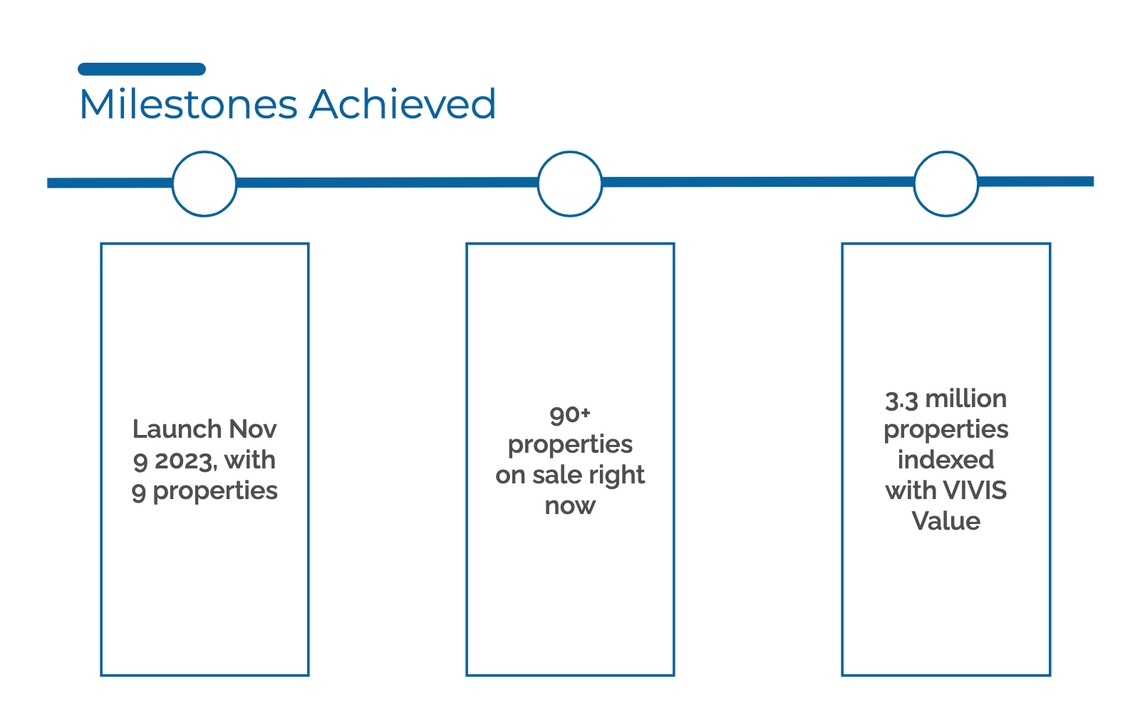
Notes:
If the company has relevant traction, add a simple overview of your revenue or MoM growth, without getting into too many details about the business itself.Skip this slide if you don't have strong numbers yet.

Slide 14


Slide 15


Slide 16


Slide 17

Notes:
If the company has relevant traction, add a simple overview of your revenue or MoM growth, without getting into too many details about the business itself.Skip this slide if you don't have strong numbers yet.

Slide 18

Notes:
If the company has relevant traction, add a simple overview of your revenue or MoM growth, without getting into too many details about the business itself.Skip this slide if you don't have strong numbers yet.

Slide 19


